Slide 1
Employee attrition analysis
Sameera Banu M

Slide 2
CONTENTS
Problem Statement
Key metrics and Overview
My Dashboard
Analysis Process
Recommendation & Summary

Slide 3
Problem statement
XYZ company which was established a few years back is facing around a 15% attrition rate for a couple of years. And it's majorly affecting the company in many aspects. In order to understand why employees are leaving the company and reduce the attrition rate XYZ company has approached an HR analytics consultancy for analyzing the data they have. You are playing the HR analyst role in this project and building a dashboard which can help the organization in making data-driven decisions.

Slide 4
Key metrics overview
Total Employees: 4410
Total Attrition: 711 employees
Attrition Rate: 16.1%
Average Age: 36.92 years
Average Tenure: 7.01 years

Slide 5
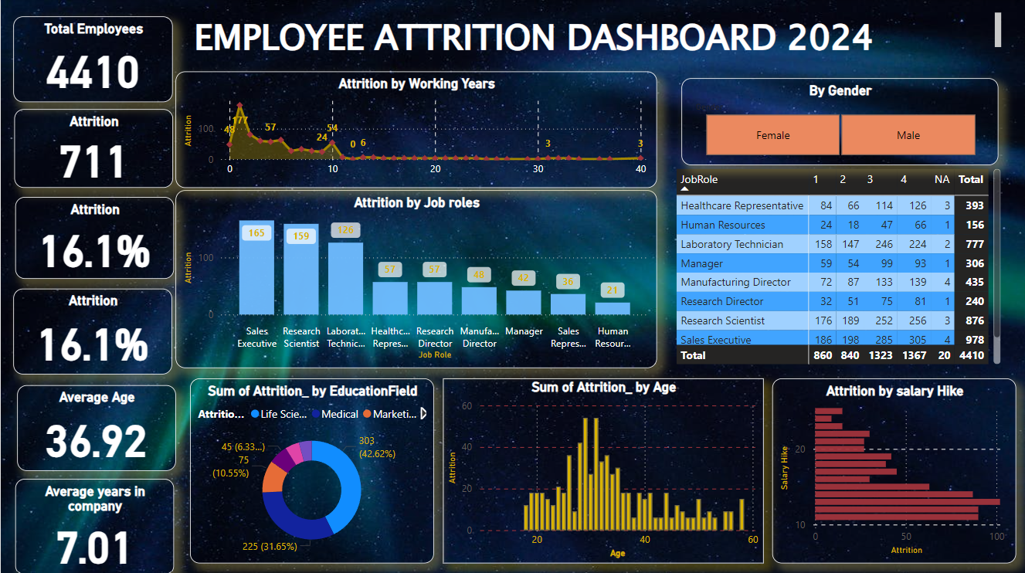
My dashboard

Slide 6
Analysis process
Job Role and Gender Analysis
Findings: Highest attrition among Sales Executives (165), Research Scientists (159), and Laboratory Technicians (126). Gender analysis revealed notable trends and discrepancies.

Slide 7
Analysis process
Working years and age Analysis
Findings: Peak attrition occurs within the first 0-10 years of employment, with a decline thereafter. The 20-30 age group has the highest attrition rate.

Slide 8
Analysis process
Educational filed and salary hike Analysis
Findings: High attrition rates in Life Sciences (42.62%) and Medical (31.6%) fields. Lower salary hikes correlate with higher attrition rates.

Slide 9
Recommendation and summary
Develop targeted retention strategies for high-risk job roles and demographics.
Implement mentoring and career development programs for employees in high attrition age and tenure groups.
Review compensation and benefits packages to ensure competitiveness, especially for critical roles.
Enhance employee engagement initiatives to address job satisfaction and workplace culture.

Slide 10
THANK YOU
Sameera Banu M
sameeramansoor03@gmail.com

